Slide 1

Introduction to Machine Learning
Modul 1
Data Science Program

Slide 2
Why ML ?
We are growing at a very faster level and demands are also increasing and require an automated and centralized system.
Can we do very difficult computations manually?

Slide 3
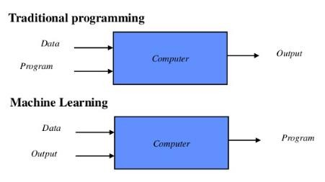
What is Machine Learning?
It is the Field of study that gives computer the capability to learn without being explicitly programmed.

Slide 4
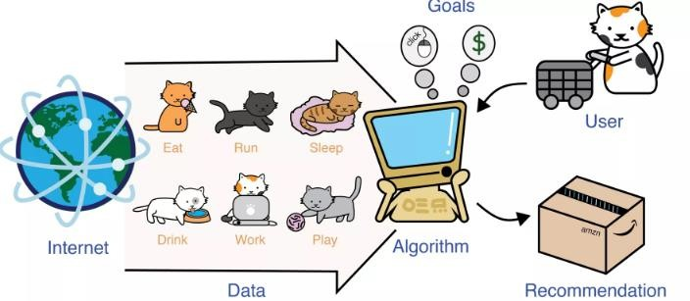
Goal of ML
Removal of redundancies
Dimensionality Reduction

Slide 5
What is it used for?
Fraud detection.
Web search results.
Real-time ads on web
pages
Credit scoring and next- best offers.
Prediction of equipment
failures.
New pricing models.
Network intrusion detection.
Recommendation Engines
Customer Segmentation
Text Sentiment Analysis
Predicting Customer Churn
Pattern and image
recognition.
Email spam filtering.
Financial Modeling

Slide 6
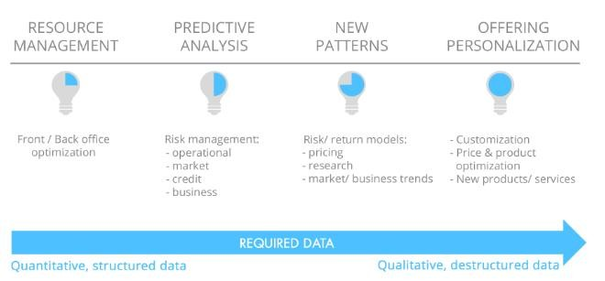
Applications of ML
MI in banking

Slide 7
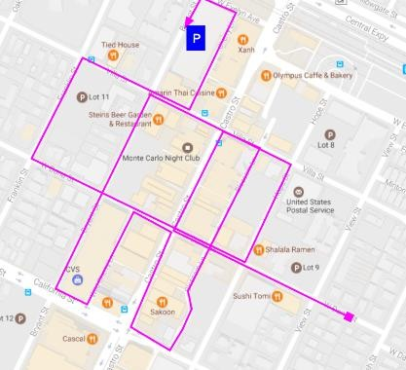
Applications of ML
Map building according to current traffic

Slide 8
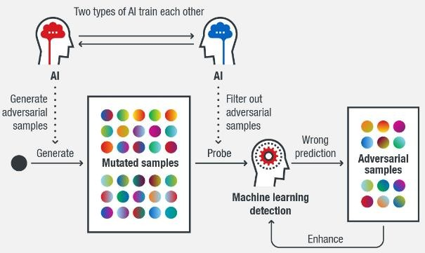
Applications of ML
Email Spam and Malware Filtering

Slide 9
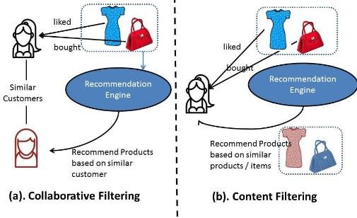
Applications of ML
Product recommendation

Slide 10
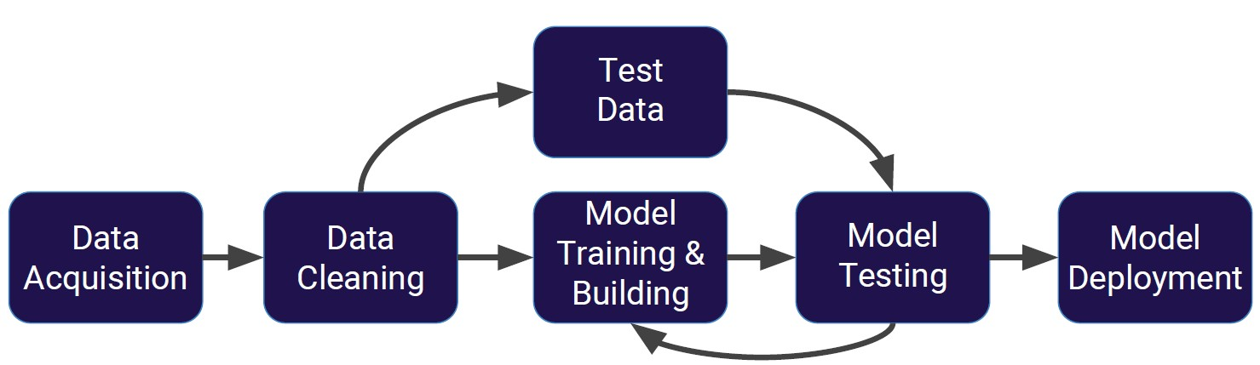
Machine Learning Process

Slide 11
Supervised Learning
Supervised learning algorithms are trained using labeled examples, such as an input where the desired output is known.

Slide 12
Supervised Learning
Through methods like classification, regression, prediction and gradient boosting, supervised learning uses patterns to predict the values of the label on additional unlabeled data.
Supervised learning is commonly used in applications where
historical data predicts likely future events.

Slide 13
Supervised Learning
For example, it can anticipate when credit card transactions are likely to be fraudulent or which insurance customer is likely to file a claim.
Or it can attempt to predict the price of a house based on different features for houses for which we have historical price data.

Slide 14
Unsupervised Learning
Unsupervised learning is used against data that has no
historical labels.
The system is not told the "right answer." The algorithm must figure out what is being shown.
The goal is to explore the data and find some structure within.

Slide 15
Unsupervised Learning
Or it can find the main attributes that separate customer segments from each other.
Popular techniques include self-organizing maps, nearest- neighbor mapping, k-means clustering and singular value decomposition.

Slide 16
Unsupervised Learning
These algorithms are also used to segment text topics, recommend items and identify data outliers.

Slide 17
Reinforcement Learning
Reinforcement learning is often used for robotics, gaming and navigation.
With reinforcement learning, the algorithm discovers through trial and error which actions yield the greatest rewards.

Slide 18
Reinforcement Learning
This type of learning has three primary components: the agent (the learner or decision maker), the environment (everything the agent interacts with) and actions (what the agent can do).

Slide 19
Reinforcement Learning
The objective is for the agent to choose actions that maximize the expected reward over a given amount of time.
The agent will reach the goal much faster by following a good policy.
So the goal in reinforcement learning is to learn the best policy.

Slide 20
Let’s start using Python for
Machine Learning!

